Slide 1
Lecture 8 Sorting

Slide 2
Outline
Introduction and Notation
Insertion Sort
Selection Sort
Shell Sort
----------------
Bucket Sort
Radix Sort
Divide-and-Conquer Sorting
Mergesort
Quicksort
Heapsort

Slide 3
Introduction
In computer science and mathematics, a sorting algorithm is an algorithm that puts elements of a list in a certain order. The most-used orders are numerical order and lexicographical order.
Efficient sorting is important to optimizing the use of other algorithms (such as search and merge algorithms) that require sorted lists to work correctly; it is also often useful for producing human-readable output.
Sorting problem has attracted a great deal of research
Bubble sort was analyzed as early as 1956.
Useful new sorting algorithms are still being invented . For example, library sort was first published in 2004.

Slide 4
Introduction
In an external sort, there are so many records to be sorted that they must be kept in external files on disks, tapes, or the like. In an internal sort the records can all be kept internally in high-speed memory. We consider only internal sorting.
To analyze sorting algorithms, we consider both the number of comparisons of keys and the number of times entries must be moved inside a list, particularly in a contiguous list.
Both the worst-case and the average performance of a sorting algorithm are of interest. To find the average, we shall consider what would happen if the algorithm were run on all possible orderings of the list (with n entries, there are n! such orderings altogether) and take the average of the results.

Slide 5
Introduction
Computational complexity (worst, average and best behavior) of element comparisons in terms of the size of the list (n). For typical sorting algorithms good behavior is O(n logn) and bad behavior is O(n²). Ideal behavior for a sort is O(n).
Memory usage (and use of other computer resources). In particular, some sorting algorithms are "in place". This means that they need only O(1) or O(log n) memory beyond the items being sorted and they don't need to create auxiliary locations for data to be temporarily stored, as in other sorting algorithms.
Recursion. Some algorithms are either recursive or non-recursive, while others may be both (e.g., merge sort).

Slide 6
Application of Sorting
唯一性测试——如何测试一个给定序列S中的元素是否两两相异？
删除序列S中的重复元素
中位数(median element)/第k小元素的选择
频率统计——哪个元素在序列S中出现的次数最多？
Find closest pair
集合的交与并
寻找目标数对——给定一个目标数z,如何检测是否存在两个整数x,y∈S，使得x+y=z?

Slide 7
Stability
Stability: stable sorting algorithms maintain the relative order of records with equal keys (i.e., values).
Assume that the following pairs of numbers are to be sorted by their first component:
(4, 1) (3, 2) (3, 3) (5, 4)
Sorted result
(3, 2) (3, 3) (4, 1) (5, 4) (order maintained)
(3, 3) (3, 2) (4, 1) (5, 4) (order changed)

Slide 8
Stability
Unstable sorting algorithms can be specially implemented to be stable.
One way of doing this is to artificially extend the key comparison, so that comparisons between two objects with otherwise equal keys are decided using the order of the entries in the original data order as a tie-breaker. Remembering this order, however, often involves an additional computational cost.

Slide 9
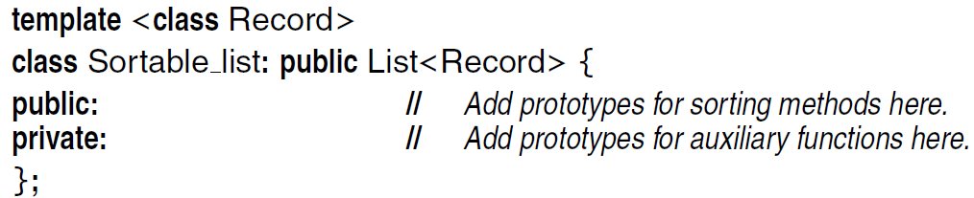
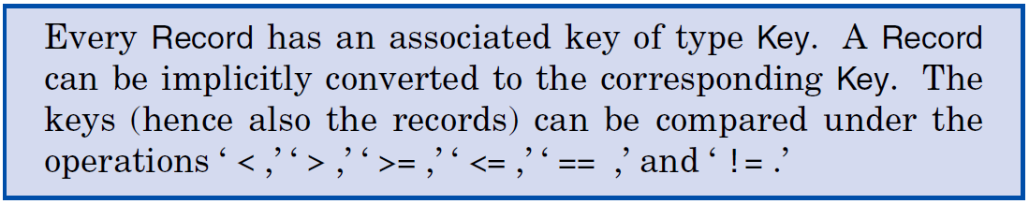
Sortable Lists
To write efficient sorting programs, we must access the private data members of the lists being sorted. Therefore, we shall add sorting functions as methods of our basic List data structures. The augmented list structure forms a new ADT that we shall call a Sortable List, with the following form:

Slide 10
Ordered Insertion
An ordered list is an abstract data type, defined as a list in which each entry has a key, and such that the keys are in order.
For ordered lists, we shall often use two new operations.
One operation retrieves an entry with a specified key from the ordered list. Retrieval by key from an ordered list is exactly the same as searching.
The second operation, ordered insertion, inserts a new entry into an ordered list by using the key in the new entry to determine where in the list to insert it.
Note that ordered insertion is not uniquely specified if the list already contains an entry with the same key as the new entry, since the new entry could go into more than one position.

Slide 11
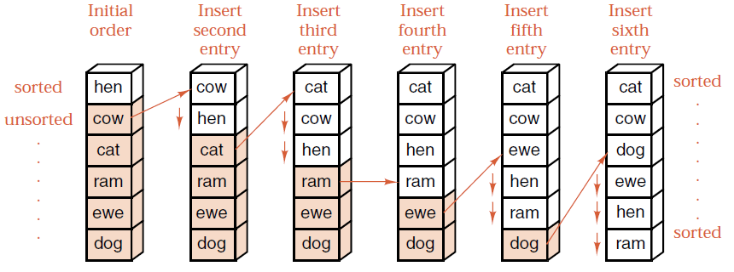
Insertion Sort
Basic Idea：Insertion sort for a list is based on the idea of insertion into an ordered list. To sort an unordered list, we think of removing its entries one at a time and then inserting each of them into an initially empty new list, always keeping the entries in the new list in the proper order according to their keys.

Slide 12
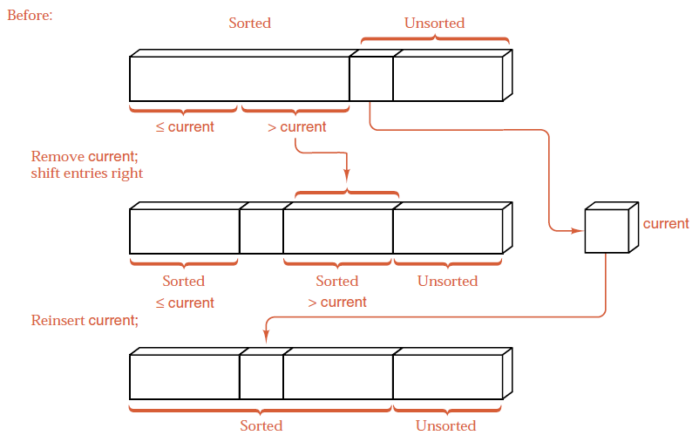
Insertion Sort

Slide 13
Insertion Sort Example
Insertion Sort Example
Original | 34 | 8 | 64 | 51 | 32 | 21 | Moved
After p=1 | 8 | 34 | 64 | 51 | 32 | 21 | 1
After p=2 | 8 | 34 | 64 | 51 | 32 | 21 | 0
After p=3 | 8 | 34 | 51 | 64 | 32 | 21 | 1
After p=4 | 8 | 32 | 34 | 51 | 64 | 21 | 3
After p=5 | 8 | 21 | 32 | 34 | 51 | 64 | 4

Slide 14
Insert Sort
A simple implementation:
for (i = 1; i < n; i++) {
key = a[i];
for (j = i - 1; j >= 0 && a[j] > key; j--)
a[j + 1] = a[j];
a[j + 1] = key;
}

Slide 15
Linked Insertion Sort
Traverse the original list, taking one entry at a time and inserting it in the proper position in the sorted list.
A sentinel is an extra entry added to one end of a list to ensure that a loop will terminate without having to include a separate check. Since last_sorted->next == first_unsorted, the node *first_unsorted is already in position to serve as a sentinel for the search, and the loop moving current is simplified.
A list with 0 or 1 entry is already sorted, so by checking these cases separately we avoid trivialities elsewhere.
The contiguous version searches the sorted sublist in reverse order, while the linked version searches it in increasing order of position within the list.

Slide 16
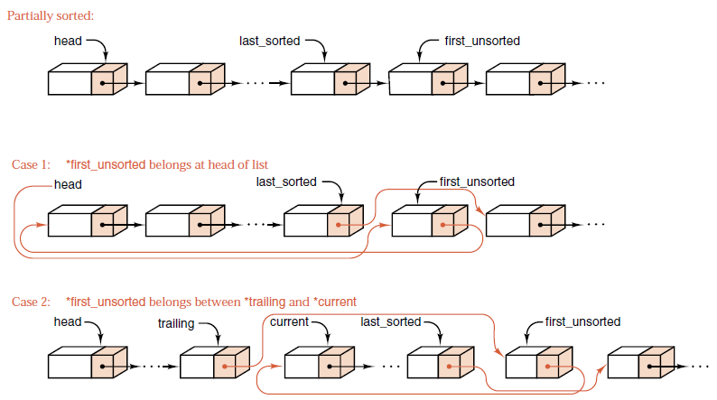
Linked Insertion Sort

Slide 17
Analysis of Insertion Sort
The average number of comparisons for insertion sort applied to a list of n items in random order is 1/4n²+O(n).
The average number of assignments of items for insertion sort applied to a list of n items in random order is also 1/4n²+O(n).
The best case for contiguous insertion sort occurs when the list is already in order, when insertion sort does nothing except n − 1 comparisons of keys.
The worst case for contiguous insertion sort occurs when the list is in reverse order.
Insertion sort is stable, it does not change the relative order of elements with equal keys.
It is In-place, i.e., only requires a constant amount O(1) of additional memory space.
Notes:
Note: 折半插入排序

Slide 18
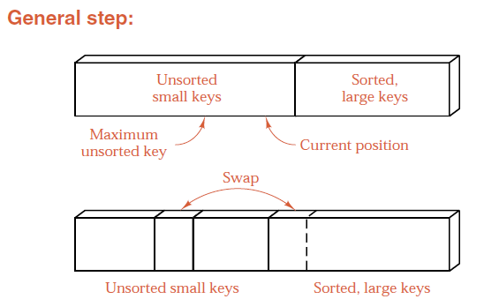
Selection Sort
Insertion sort has one disadvantage: insertion of an entry may require many entries to be moved. This can be expensive especially when the entries are large.
Basic Idea of Selection Sort
Scan the unsorted list and find the largest, then exchange this entry with the entry in the last position.
Repeat the process on the unsorted list until the length of unsorted list is 1.

Slide 19
Selection Sort
A simple implementation:
for (i = 0; i < n; i++) {
k = i;
for (j = i + 1; j < n; j++)
if (a[j] < a[k]) k = j;
swap(a[i], a[k]);
}

Slide 20
Selection Sort
Selection sort minimizes data movement, it is useful for contiguous lists with large entries for which movement of entries is expensive.
Original： 21，25，49，25*，16，08
p=1
p=2
p=3
p=4
p=5
08，25，49，25*，16，21
08，16, 49，25*，25，21
08，16, 21，25*，25，49
08，16, 21，25*，25，49
08，16, 21，25*，25，49
选择排序
时间效率： O(n²) ——虽移动次数较少，但比较次数仍多。
空间效率：O(1) ——因为仅占用1个缓冲单元！
算法的稳定性：不稳定——因为排序时，25*到了25的前面。

Slide 21
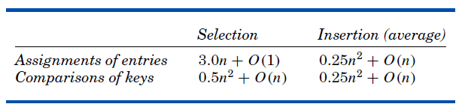
Analysis of Selection Sort
The number of comparisons:
(n-1)+(n-2)+…+1 = ½ n(n+1) ≈ ½ n² + O(n)
The number of assignments: 3(n-1)
Analysis and comparisons:
Notes:
Note: Bubble Sort

Slide 22
Shell Sort
Shell sort was invented by Donald Shell in 1959. It improves upon bubble sort and insertion sort by moving out of order elements more than one position at a time.
Insertion sort is inefficient in moving entries only one position at a time. It takes several insertion for a entry in its correct position. The reason is it only compares adjacent entries.
How to reduce the number of movements?
Idea: If we compare entries far apart, then it could sort the entries far apart. Finally, the increment between keys being compared is reduced to 1.

Slide 23
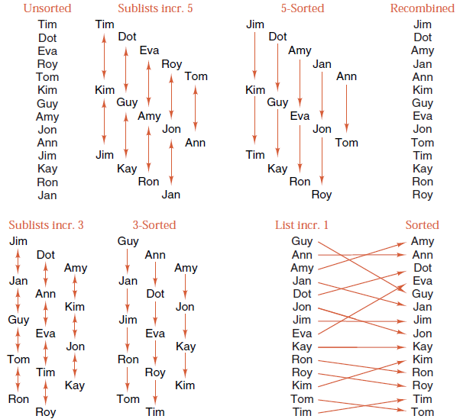
Shell Sort

Slide 24
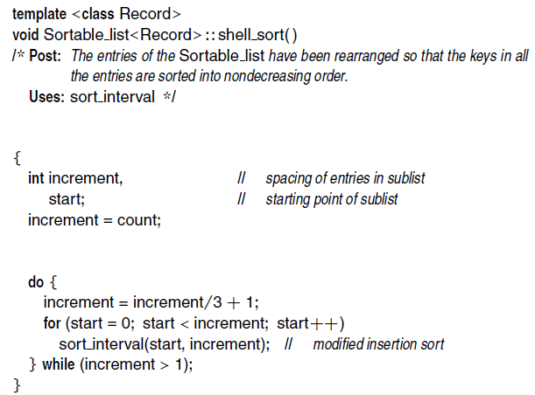
Contiguous implementation

Slide 25
Shell Sort Example
例：关键字序列 T=(49,38,65,97,76,13,27,49*,55,04），
请写出希尔排序的具体实现过程。
r[i]
0 | 1 | 2 | 3 | 4 | 5 | 6 | 7 | 8 | 9 | 10
 | 49 | 38 | 65 | 97 | 76 | 13 | 27 | 49* | 55 | 04
初态：
第1趟 (inc=5)
49
13
38
27
49*
65
97
55
76
04
13
49
27
38
49*
65
55
97
04
76
第2趟 (inc=3)
13
13
27
04
49*
49*
55
38
04
27
49
49
38
55
65
65
97
97
76
76
第3趟 (inc=1)
13
04
04
13
49*
27
38
49*
27
49
55
65
97
76
76
97

Slide 26
Shell Sort Example
算法分析：开始时inc 的值较大，子序列中的对象较少，排序速度较快；随着排序进展，inc 值逐渐变小，子序列中对象个数逐渐变多，由于前面工作的基础，大多数对象已基本有序，所以排序速度仍然很快。
时间效率：O(n^{4/3}）～O(n²)——希尔增量、Hibbard增量等
空间效率：O(n)
算法的稳定性：不稳定——因为49*排序后却到了49的前面
Exercise:
Use Shell Sort to sort [256，301，751，129，937，863，742，694，076，438]
increment = 5, 3, 1

Slide 27
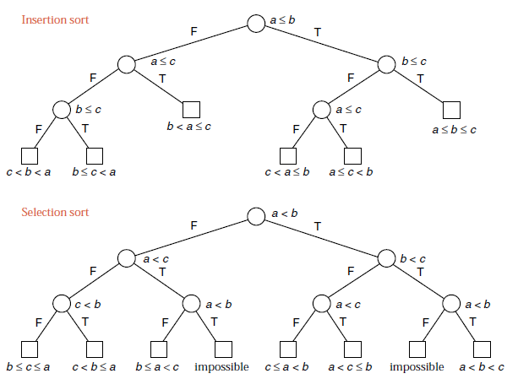
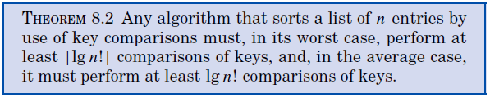
Lower Bounds for Sorting

Slide 28
Approximation for factorials
Stirling’s approximation

Slide 29

Thank you!

